Slide 1
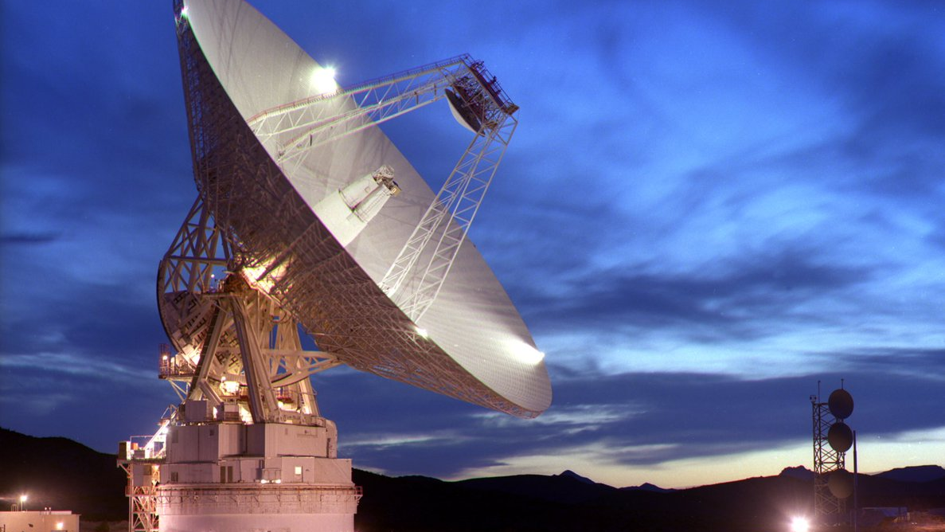

LASSO
Localize, Attribute SatelliteS in Orbit
P20151
TDoA Algorithm
https://twitter.com/tanyaofmars/status/893892863485919232

Slide 2
The TDoA simulator
Agenda
1. Time Difference of Arrival (TDoA) Introduction.
2. The Satellite Problem
3. Finding the Best Solution on a Plane
4. Fitting a Line through the solution on each plane.
5. Unit Tests
6. Simulating the Inputs
7. Deriving the Uncertainty based on Simulated Inputs

Slide 3
Purpose Of Slides
Inform reader about how the Time Difference of Arrival algorithm works.
This is not designed as presentation slides. The slides are filled with information and comments. It is meant to be read like a paper (but with lots of pictures).

Slide 4
TDoA Basics
By Anthony Iannuzzi

Slide 5
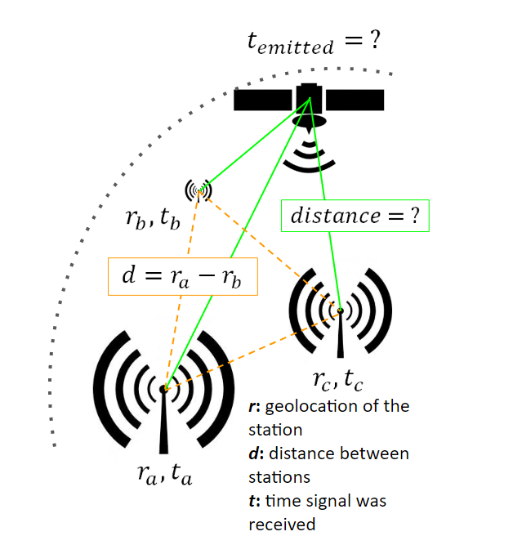
What is TDoA?
Time Difference of Arrival triangulates friendly or hostile RF sources using hyperboloids generated from time delays calculated from the arrival time of the signal across 3 or more synchronized stations.

Slide 6
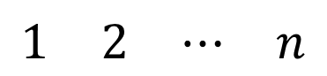
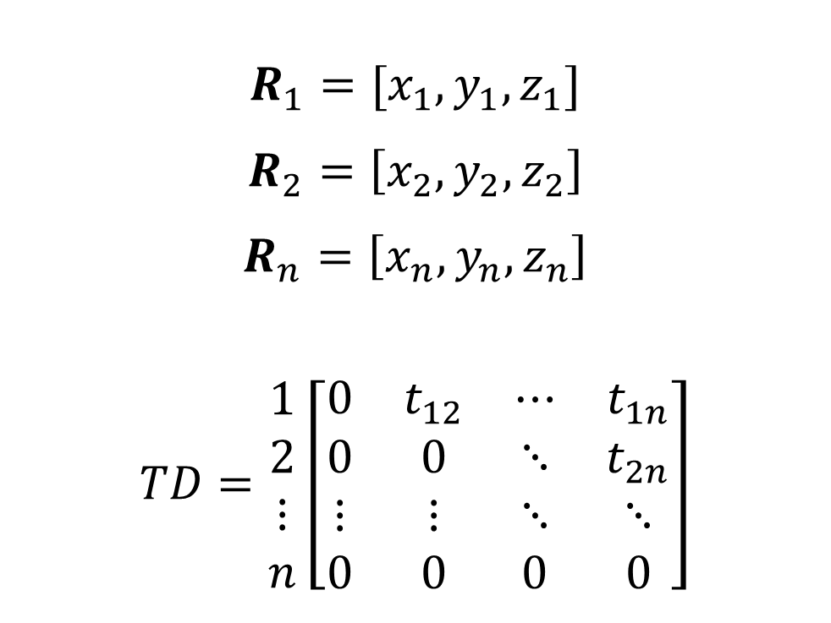
TDoA data is receiver locations and time differences between each receiver.
$$R_{1}=[x_{1},y_{1},z_{1}]$$
$$R_{2}=\left[x_{2},y_{2},z_{2}\right]$$
$$R_{n}=\left[x_{n},y_{n},z_{n}\right]$$
$$TD=\begin{matrix}1 \\ 2 \\ ⋮ \\ n\end{matrix}\left[\begin{matrix}0 & t_{12} & ⋯ & t_{1n} \\ 0 & 0 & ⋱ & t_{2n} \\ ⋮ & ⋮ & ⋱ & ⋱ \\ 0 & 0 & 0 & 0\end{matrix}\right]$$
The receivers must all be measured in the same frame.
TD represents the Time Difference data. It is an upper triangular matrix. Each entry is the time difference between the receivers represented by that row and column number.
$$\begin{matrix}1 & 2 & ⋯ & n\end{matrix}$$
The diagonals are zero as a station compared to itself has no time difference. The lower triangle contains redundant information and is set to 0.

Slide 7
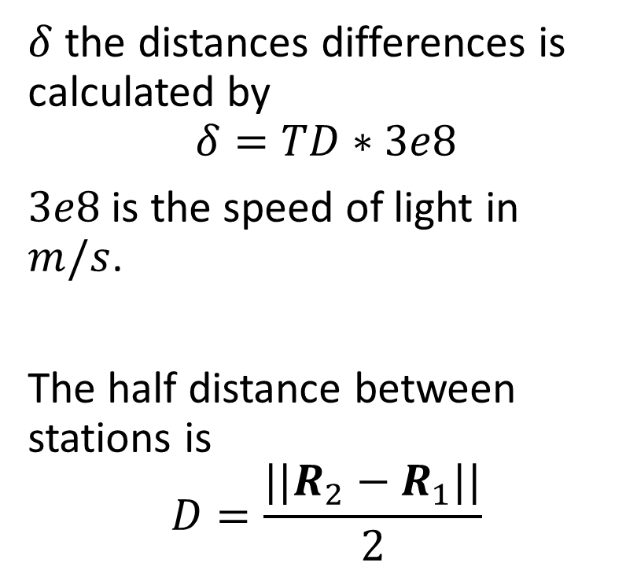
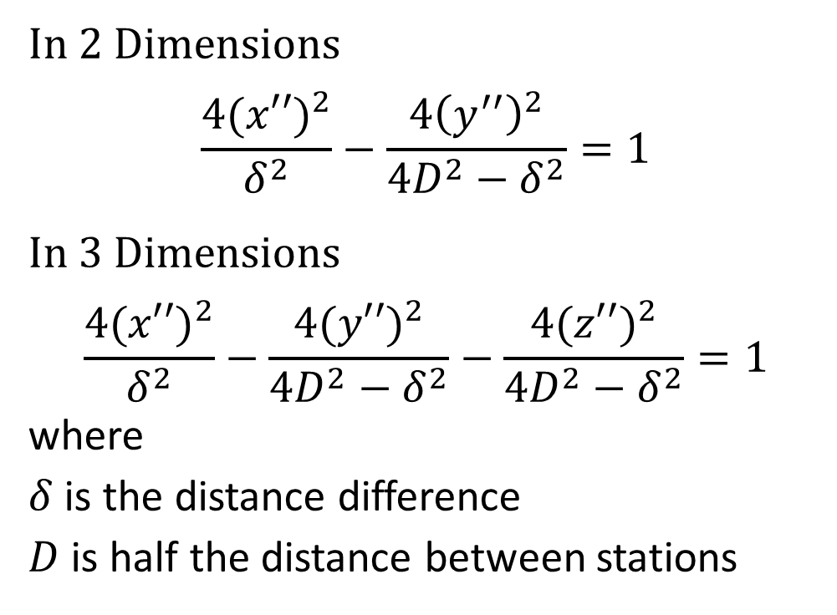
TDoA data creates hyperbolas and hyperboloids.
In 2 Dimensions
$$\frac{4{(x′′)}^{2}}{δ^{2}}−\frac{4{\left(y^{′′}\right)}^{2}}{4D^{2}−δ^{2}}=1$$
In 3 Dimensions
$$\frac{4{(x′′)}^{2}}{δ^{2}}−\frac{4{(y′′)}^{2}}{4D^{2}−δ^{2}}−\frac{4{(z′′)}^{2}}{4D^{2}−δ^{2}}=1$$
where
$δ$ is the distance difference
$D$ is half the distance between stations
$δ$ the distances differences is calculated by
$$δ=TD∗3e8$$
$3e8$ is the speed of light in $m/s$.
The half distance between stations is
$$D=\frac{||R_{2}−R_{1}||}{2}$$

Slide 8
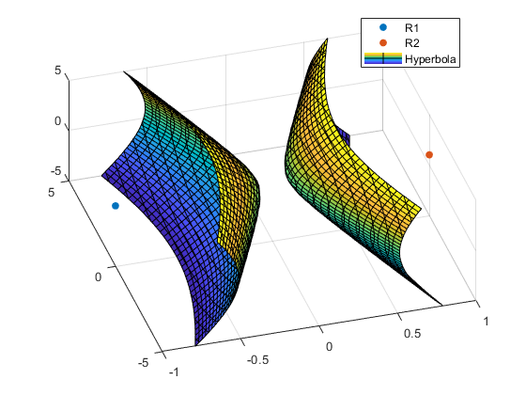
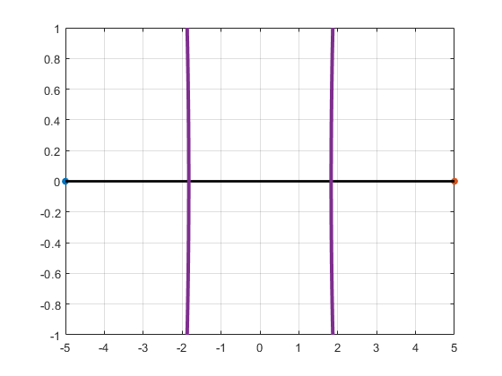
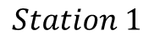
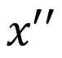
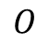
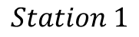
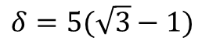
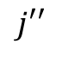
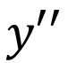
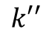
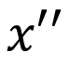
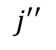
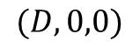
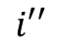
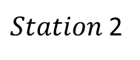
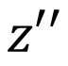
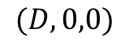
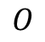
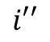
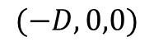
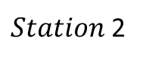
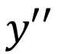
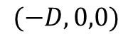
Graphically what hyperboloid and hyperbola look like.
$$j′′$$
$$k′′$$
$$z′′$$
$Station$2
$$δ=5(\sqrt{3}−1)$$
$$i′′$$
$$(D,0,0)$$
$$j′′$$
$$y′′$$
$$(−D,0,0)$$
$$O$$
$Station$2
$$(−D,0,0)$$
$$O$$
$$Station 1$$
$$i′′$$
$$(D,0,0)$$
$$Station 1$$
$$y′′$$
$$(−D,0,0)$$
$$x′′$$
$$x′′$$
These Hyperbolas assume the stations are located at $(±D,0,0)$. This is called the Body Frame. We will now transform this hyperbola into the Fixed Frame; the frame the stations are measured in.

Slide 9
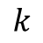
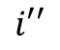
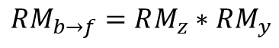
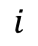
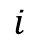
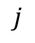
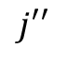
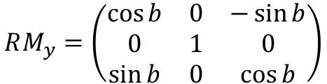
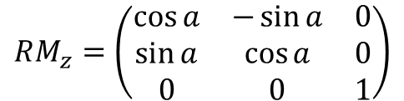
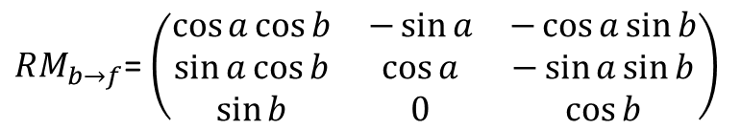
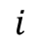
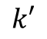
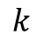
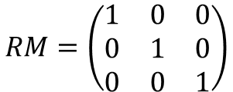
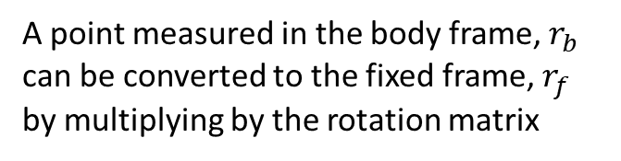
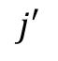
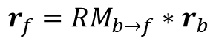
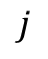
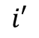
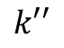
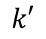
Coordinate Transformation Introduction
Azimuth, Elevation Rotations
$$k$$
$$k$$
$$k′$$
$$k′′$$
$$k$$
$$k′$$
$$j′$$
$$j′′$$
$$j′$$
$$j$$
$$j$$
The point we want to transform
$$j$$
$$i′′$$
$$i$$
$$i$$
$$i′$$
$$i$$
$$i′$$
Fixed Frame
Intermediate Frame
Body Frame
$$RM=\left(\begin{matrix}1 & 0 & 0 \\ 0 & 1 & 0 \\ 0 & 0 & 1\end{matrix}\right)$$
$$RM_{z}=\left(\begin{matrix}\cos{a} & −\sin{a} & 0 \\ \sin{a} & \cos{a} & 0 \\ 0 & 0 & 1\end{matrix}\right)$$
$$RM_{y}=\left(\begin{matrix}\cos{b} & 0 & −\sin{b} \\ 0 & 1 & 0 \\ \sin{b} & 0 & \cos{b}\end{matrix}\right)$$
A point measured in the body frame, $r_{b}$ can be converted to the fixed frame, $r_{f}$ by multiplying by the rotation matrix
$$RM_{b→f}=RM_{z}∗RM_{y}$$
$RM_{b→f}$= $\left(\begin{matrix}\cos{a}\cos{b} & −\sin{a} & −\cos{a}\sin{b} \\ \sin{a}\cos{b} & \cos{a} & −\sin{a}\sin{b} \\ \sin{b} & 0 & \cos{b}\end{matrix}\right)$
$$r_{f}=RM_{b→f}∗r_{b}$$

Slide 10






Calculating Azimuth and Elevation
How to calculate Azimuth, Elevation Rotations
$$k$$
$$k$$
$$k′$$
$$k′′$$
$$k$$
$$k′$$
$$j′$$
$$j′′$$
$$j′$$
$$j$$
$$j$$
$$(x_{s},y_{s},z_{s})$$
$$j$$
$$i′′$$
$$i$$
$$i$$
$$i′$$
$$i$$
$$i′$$
Fixed Frame
Intermediate Frame
Body Frame
Azimuth
Elevation
$$a=\tan^{−1}{\frac{y_{s}}{x_{s}}}$$
$$b=\tan^{−1}{\frac{z_{s}}{\sqrt{x_{s}^{2}+y_{s}^{2}}}}$$
$$Given:\left[x_{s},y_{s},z_{s}\right]$$
If we have the point measured in the fixed frame, then we can calculate the azimuth and elevation with respect to the fixed frame.

Slide 11














Transforming Coordinate Axes that have different origins.
$$k$$
Rotate to the Fixed coordinate frame orientation.
Then shift coordinate frame.
Fixed Frame
Intermediate Frame
$$k′′$$
Body Frame
$$Given: P=\left[x_{0},y_{0},z_{0}\right]$$
$$k$$
$$j′′$$
$$O$$
$$r_{f}=RM_{b→f}∗r_{b}^{T}−P^{T}$$
$$j$$
$$P$$
1.
2.
$$j$$
$$i$$
$$i$$
$$i′′$$
Physically, each entry in the RM can be regarded as a dot product between each body and fixed frame axis:
$RM_{b→f}=$ $\begin{matrix} & i & j & k \\ i′′ & \cos{a}\cos{b} & −\sin{a} & −\cos{a}\sin{b} \\ j′′ & \sin{a}\cos{b} & \cos{a} & −\sin{a}\sin{b} \\ k′′ & \sin{b} & 0 & \cos{b}\end{matrix}$

Slide 12

Transforming the Hyperbola or Hyperboloid to the Fixed Frame. Known Data.
Given Absolute Position of Stations:
$$R_{1}=[x_{1},y_{1},z_{1}]$$
$$R_{2}=\left[x_{2},y_{2},z_{2}\right]$$
$$D=\frac{||R_{2}−R_{1}||}{2}$$
$$O=R_{1}+\frac{R_{2}−R_{1}}{2}$$
x axis always points from station 1 to 2.
$$\left[x_{s},y_{s},z_{s}\right]=R_{2}−O$$

Slide 13


Transforming the Hyperbola or Hyperboloid to the Fixed Frame. The new Equation
Let $r={\left[x−x_{0},y−y_{0},z−z_{0}\right]}^{T}$, then the hyperboloid becomes:
$$\frac{4{(r∙RM(:,1))}^{2}}{δ^{2}}−\frac{4{(r∙RM\left(:,2\right))}^{2}}{4D^{2}−δ^{2}}−\frac{4{(r∙RM\left(:,3\right))}^{2}}{4D^{2}−δ^{2}}=1$$
Substitute $\left[x^{′′},y^{′′},z^{′′}\right]$for
$RM∗r^{T}$ split amongst the terms.
$$dot product$$

Slide 14
Hyperboloid in Fixed Frame
Let $r={\left[x−x_{0},y−y_{0},z−z_{0}\right]}^{T}$, then the hyperboloid becomes:
$$\frac{4{(r∙RM(:,1))}^{2}}{δ^{2}}−\frac{4{(r∙RM\left(:,2\right))}^{2}}{4D^{2}−δ^{2}}−\frac{4{(r∙RM\left(:,3\right))}^{2}}{4D^{2}−δ^{2}}=1$$
Substitute $\left[x^{′′},y^{′′},z^{′′}\right]$for
$RM∗r^{T}$ split amongst the terms.
$$dot product$$

Slide 15



















Transforming the Hyperbola or Hyperboloid to the Fixed Frame. Visualization
Body Frame
Fixed Frame
$$R_{2}$$
$Station$2
$$(x_{2},y_{2},z_{2})$$
$$j′′$$
$$(−D,0,0)$$
$$O$$
$Station$2
$$j′′$$
$$y′′$$
$$y$$
$$i′′$$
$$Station 1$$
$$i′′$$
$$(D,0,0)$$
$$O$$
$$2∗D$$
$$2∗D$$
$$R_{1}$$
$$x′′$$
$Station$1
$$x$$
$$(x_{1},y_{1},z_{1})$$

Slide 16



Creating the Hyperboloids and Hyperbolas algorithm.
Inputs is TDoA Data
Receiver Locations in the Fixed Frame
Distance Difference
Algorithm:
Calculate $RM_{b→f}$ and offset $P$
Create Hyperboloid in Body Frame.
Transform to Fixed Frame.
Outputs:
Symbolic Equation of Hyperboloid
Yes
$$\frac{4{(r∙RM(:,1))}^{2}}{δ^{2}}−\frac{4{(r∙RM\left(:,2\right))}^{2}}{4D^{2}−δ^{2}}−\frac{4{(r∙RM\left(:,3\right))}^{2}}{4D^{2}−δ^{2}}=1$$

Slide 17

Changing to a 1 sided Hyperbola
2 sided Hyperbola
$$\frac{4{(x′′)}^{2}}{δ^{2}}−\frac{4{(y′′)}^{2}}{4D^{2}−δ^{2}}−\frac{4{(z′′)}^{2}}{4D^{2}−δ^{2}}=1$$
1 sided Hyperbola (solve for $x’’$)
$$x′′=δ\sqrt{\frac{1}{4}+\frac{{(y′′)}^{2}}{4D^{2}−δ^{2}}+\frac{{(z′′)}^{2}}{4D^{2}−δ^{2}}}$$
where
$δ$ is the distance difference
$D$ is half the distance between stations

Slide 18








Choose the Hyperbola side based on the sign of the distance difference.
$$\left|δ\right|=5\left(\sqrt{3}−1\right)=−3.66$$
$$R_{2}$$
The sign of $x′′$ is wholly dictated by sign of delta.
$$x^{′′}=δ\sqrt{\frac{1}{4}+\frac{{(y′′)}^{2}}{4D^{2}−δ^{2}}+\frac{{(z′′)}^{2}}{4D^{2}−δ^{2}}}$$
where
$δ$ is the distance difference
$D$ is half the distance between stations
$$x′′$$
$$δ=−3.66$$
$$x^{′′}=−$$
$$D$$
$$R_{1}$$

Slide 19



Solution is much less ambiguous with 1 sided Hyperbolas
But how many hyperbolas are created from $n$ number of stations?
How do we find the “best solution”?

Slide 20




TDoA data creates $\frac{n\left(n−1\right)\left(n−2\right)}{6}$ hyperboloids.
Recall the TDoA Data
$$R_{1}=[x_{1},y_{1},z_{1}]$$
$$R_{2}=\left[x_{2},y_{2},z_{2}\right]$$
$$R_{n}=\left[x_{n},y_{n},z_{n}\right]$$
$$TD=\begin{matrix}1 \\ 2 \\ ⋮ \\ n\end{matrix}\left[\begin{matrix}0 & t_{12} & ⋯ & t_{1n} \\ 0 & 0 & ⋱ & t_{2n} \\ ⋮ & ⋮ & ⋱ & ⋱ \\ 0 & 0 & 0 & 0\end{matrix}\right]$$
For $n=3$, we have 3 Hyperboloids.
For $n=4$, we have 6 Hyperboloids.
Number of unique Hyperboloids.
Given $n=3$, we have
$$H_{12},H_{13},H_{23}$$
Only 2 of these hyperboloids are unique.
For $n=4$, we have 3 unique Hyperboloids.
$$\begin{matrix}1 & 2 & ⋯ & n\end{matrix}$$

Slide 21




Intersecting Hyperbolas in 2D.
$$H_{A}=\frac{4{(r_{A}∙RM_{A}(:,1))}^{2}}{δ_{A}^{2}}−\frac{4{(r_{A}∙RM_{A}\left(:,2\right))}^{2}}{4D_{A}^{2}−δ_{A}^{2}}=1$$
$$H_{B}=\frac{4{(r_{B}∙RM_{B}(:,1))}^{2}}{δ_{B}^{2}}−\frac{4{(r_{B}∙RM_{B}\left(:,2\right))}^{2}}{4D_{B}^{2}−δ_{B}^{2}}=1$$
Intersection is $H_{A}−H_{B}=0$
This works for both one-sided and two-sided Hyperbolas.
For one-sided Hyperbolas, must remove fake solutions by plugging in all solutions back into $H_{A}$ and $H_{B}$ to verify they are indeed on the Hyperbola.

Slide 22




Removing the Fake Solutions for One-sided Hyperbolas.
$$r_{A}∙RM_{A}(:,1)=δ_{A}\sqrt{\frac{1}{4}+\frac{{(r_{A}∙RM_{A}\left(:,2\right))}^{2}}{4D_{A}^{2}−δ_{A}^{2}}}$$
$$r_{B}∙RM_{B}(:,1)=δ_{B}\sqrt{\frac{1}{4}+\frac{{(r_{B}∙RM_{B}\left(:,2\right))}^{2}}{4D_{B}^{2}−δ_{B}^{2}}}$$
Intersection is $H_{A}−H_{B}=0$
For one-sided Hyperbolas, must remove fake solutions by plugging in all solutions back into $H_{A}$ and $H_{B}$ to verify they are indeed on the Hyperbola.
Fake solutions come from squaring both sides when going to solve the one-sided equation.
Fake Solutions

Slide 23

The one-sided method breaks down when the sign of the Time Difference is questionable.
The one-sided method requires signed time differences.
Consider the following time differences:
$TD=1.2us±0.1us$
$TD=0.05us±0.1us$
The sign of TD is unambiguous in case (A).
The sign of TD is ambiguous in case (B) with respect to its uncertainty value.
Time differences approach zero as the emitter goes directly in between two receivers. TD Error becomes more significant at these points and the one-sided method may begin breaking down.

Slide 24


Intersecting 2 Hyperboloids results in a Hyperbola.
If the Hyperboloids are one-sided, the result is a one-sided Hyperbola.
Still working on whether we can mathematically derive this intersection hyperbola.

Slide 25
Finding Best Solution
By Anthony Iannuzzi

Slide 26
For one-sided Hyperbolas, finding the best solution is the average of 3 points.
Three one-sided hyperbolas intersect at 3 points only.
The blue circle is the correct answer.
The black dot in the center of the enclosed triangular shape is the “best solution”.

Slide 27


TDoA in 2D is very sensitive to errors outside its “triangle of receivers”.
TDoA error generally looks like this:
The blue circle is the correct answer.
The black dot in the center of the enclosed triangular shape is the “best solution”.
Position error is large, but the direction is still accurate.

Slide 28
Finding the best solution for two-sided hyperbolas is significantly harder.
Two-sided hyperbolas intersect in 12 different locations.
Which cluster is the best solution?
The one with the smallest area?
Approach:
Find all clustered locations by intersecting the hyperbolas 2 at a time.

Slide 29



Example with no error: 2 clusters are close, but they still form a triangle.
1 | 7.0001 | 0.9998
 | 7.1886 | 2.3197
 | 2.4457 | 3.8727
 | 2.0964 | 5.0562
2 | 1.9290 | -5.5781
 | 7.0000 | 1.0001
 | 2.0963 | 5.0564
 | 9.3175 | 9.0656
3 | 6.9888 | 0.9970
 | 8.0753 | 1.8799
 | 0.6839 | 4.8581
 | 2.0965 | 5.0565
Numerical precision prevents the 3 points from lining up $exactly$.
Intersecting 3 hyperbolas results in no solution.
$$H_{A}−H_{B}=0$$
Where $H_{A},H_{B}$ are equations of Hyperboloids.

Slide 30
First sort the data with respect to x then y. Differentiate the data. Single out the data below 0.1 difference.
 | x sorted | y sorted | difference | difference
1 | 0.6839 | 4.8581 | 1.2451 | -10.4362
2 | 1.9290 | -5.5781 | 0.1673 | 10.6345
3 | 2.0963 | 5.0564 | 0.0001 | -0.0002
4 | 2.0964 | 5.0562 | 0.0001 | 0.0003
5 | 2.0965 | 5.0565 | 0.3492 | -1.1838
6 | 2.4457 | 3.8727 | 4.5431 | -2.8757
7 | 6.9888 | 0.9970 | 0.0112 | 0.0031
8 | 7.0000 | 1.0001 | 0.0001 | -0.0003
9 | 7.0001 | 0.9998 | 0.1885 | 1.3199
10 | 7.1886 | 2.3197 | 0.8866 | -0.4399
11 | 8.0753 | 1.8799 | 1.2423 | 7.1858
12 | 9.3175 | 9.0656

Slide 31

Decide how many solutions there are by looking for which singled out points are clustered.
Collect the indices of all singled out differences.
$$Indices=[3,4,7,8]$$
Take the differences of these differences.
$$diff\left(Indices\right)=[1,3,1]$$
$$diff\left(Indices\right)−1=[0,2,0]$$
The number of solutions is equal to the number of non-zero terms.
Index | Diff - 1 | x sorted | y sorted | difference | difference
1 |  | 0.6839 | 4.8581 | 1.2451 | -10.4362
2 |  | 1.9290 | -5.5781 | 0.1673 | 10.6345
3 | 0 | 2.0963 | 5.0564 | 0.0001 | -0.0002
4 | 2 | 2.0964 | 5.0562 | 0.0001 | 0.0003
5 |  | 2.0965 | 5.0565 | 0.3492 | -1.1838
6 |  | 2.4457 | 3.8727 | 4.5431 | -2.8757
7 | 0 | 6.9888 | 0.9970 | 0.0112 | 0.0031
8 |  | 7.0000 | 1.0001 | 0.0001 | -0.0003
9 | 0 | 7.0001 | 0.9998 | 0.1885 | 1.3199
10 |  | 7.1886 | 2.3197 | 0.8866 | -0.4399
11 |  | 8.0753 | 1.8799 | 1.2423 | 7.1858
12 |  | 9.3175 | 9.0656

Slide 32

The critical points to collect are the beginning, end, and all non-zero terms in Diff-1.
$$diff\left(Indices\right)−1=[0,2,0]$$
The number of solutions is equal to the number of non-zero terms.
The critical points identify switching between solutions.
The first critical point is always 0.
The last critical point is the number of singled out points. (4 in this ex.)
$$criticalPoints=[0,2,4]$$
Index | Diff - 1 | x sorted | y sorted | difference | difference
1 |  | 0.6839 | 4.8581 | 1.2451 | -10.4362
2 |  | 1.9290 | -5.5781 | 0.1673 | 10.6345
3 | 0 | 2.0963 | 5.0564 | 0.0001 | -0.0002
4 | 2 | 2.0964 | 5.0562 | 0.0001 | 0.0003
5 |  | 2.0965 | 5.0565 | 0.3492 | -1.1838
6 |  | 2.4457 | 3.8727 | 4.5431 | -2.8757
7 | 0 | 6.9888 | 0.9970 | 0.0112 | 0.0031
8 |  | 7.0000 | 1.0001 | 0.0001 | -0.0003
9 | 0 | 7.0001 | 0.9998 | 0.1885 | 1.3199
10 |  | 7.1886 | 2.3197 | 0.8866 | -0.4399
11 |  | 8.0753 | 1.8799 | 1.2423 | 7.1858
12 |  | 9.3175 | 9.0656

Slide 33

Use critical points to identify the indices of the solution
Index | Diff - 1 | x sorted | y sorted | difference | difference
1 |  | 0.6839 | 4.8581 | 1.2451 | -10.4362
2 |  | 1.9290 | -5.5781 | 0.1673 | 10.6345
3 | 0 | 2.0963 | 5.0564 | 0.0001 | -0.0002
4 | 2 | 2.0964 | 5.0562 | 0.0001 | 0.0003
5 |  | 2.0965 | 5.0565 | 0.3492 | -1.1838
6 |  | 2.4457 | 3.8727 | 4.5431 | -2.8757
7 | 0 | 6.9888 | 0.9970 | 0.0112 | 0.0031
8 |  | 7.0000 | 1.0001 | 0.0001 | -0.0003
9 |  | 7.0001 | 0.9998 | 0.1885 | 1.3199
10 |  | 7.1886 | 2.3197 | 0.8866 | -0.4399
11 |  | 8.0753 | 1.8799 | 1.2423 | 7.1858
12 |  | 9.3175 | 9.0656
$$Indices=[3,4,7,8]$$
$$criticalPoints=[0,2,4]$$
We now iterate through critical points, collecting all data between the previous and current critical point:
$$Indices\left(split\left(i\right)+1:split\left(i+1\right)\right)$$
For the first solution we have
$$Indices\left(1:2\right)=[3,4]$$
For the second solution we have
$$Indices\left(3:4\right)=[7,8]$$

Slide 34

The last point in the cluster is the point directly above the identified ranges.
Index | Diff - 1 | x sorted | y sorted | difference | difference
1 |  | 0.6839 | 4.8581 | 1.2451 | -10.4362
2 |  | 1.9290 | -5.5781 | 0.1673 | 10.6345
3 | 0 | 2.0963 | 5.0564 | 0.0001 | -0.0002
4 | 2 | 2.0964 | 5.0562 | 0.0001 | 0.0003
5 |  | 2.0965 | 5.0565 | 0.3492 | -1.1838
6 |  | 2.4457 | 3.8727 | 4.5431 | -2.8757
7 | 0 | 6.9888 | 0.9970 | 0.0112 | 0.0031
8 |  | 7.0000 | 1.0001 | 0.0001 | -0.0003
9 |  | 7.0001 | 0.9998 | 0.1885 | 1.3199
10 |  | 7.1886 | 2.3197 | 0.8866 | -0.4399
11 |  | 8.0753 | 1.8799 | 1.2423 | 7.1858
12 |  | 9.3175 | 9.0656
For the first solution we have
$$Indices\left(1:2\right)=[3,4]$$
For the second solution we have
$$Indices\left(3:4\right)=[7,8]$$
The diff function lags one element behind. We add the next consecutive element to each solution:
$$soln1=[3,4,5]$$
$$soln2=[7,8,9]$$

Slide 35


Finally, average the solution together.
Index | Diff - 1 | x sorted | y sorted | difference | difference
1 |  | 0.6839 | 4.8581 | 1.2451 | -10.4362
2 |  | 1.9290 | -5.5781 | 0.1673 | 10.6345
3 | 0 | 2.0963 | 5.0564 | 0.0001 | -0.0002
4 | 2 | 2.0964 | 5.0562 | 0.0001 | 0.0003
5 |  | 2.0965 | 5.0565 | 0.3492 | -1.1838
6 |  | 2.4457 | 3.8727 | 4.5431 | -2.8757
7 | 0 | 6.9888 | 0.9970 | 0.0112 | 0.0031
8 |  | 7.0000 | 1.0001 | 0.0001 | -0.0003
9 |  | 7.0001 | 0.9998 | 0.1885 | 1.3199
10 |  | 7.1886 | 2.3197 | 0.8866 | -0.4399
11 |  | 8.0753 | 1.8799 | 1.2423 | 7.1858
12 |  | 9.3175 | 9.0656
$$(2.0964,5.05637)$$
$$(6.9963,0.999)$$

Slide 36

Choose the “Best” Solution Flowchart

Slide 37
Limitations to this algorithm
This algorithm works well for 2 clusters of points.
It does not work well when there are 4 clusters of points with roughly the same size:
Averaging the points makes sense for a near equilateral triangle. It might not for an isosceles triangle.

Slide 38
The Satellite Problem
By Anthony Iannuzzi

Slide 39


The satellite is much closer to the station near elevation 90$°$ than at lower elevations.
http://deepearthscience.blogspot.com/2015/06/diy-satellite-pass-planner.html

Slide 40



The satellite is far away from the plane of the receivers except when elevation is $\sim 0°$
The satellite is far away from the receivers.
For the case of elevation $\sim 0°$, the satellite is far outside the “triangle”.
For any other elevation, the satellite is on a different plane.
https://www.researchgate.net/figure/Satellite-Azimuth-and-elevation-angle_fig1_334197029

Slide 41


Far away, hyperbolas look like cones.
Hyperbolas approach a line as $x$ or $y$ approach infinity.
A 2D one-sided hyperbola is:
$$x^{′′}=δ\sqrt{\frac{1}{4}+\frac{{(y′′)}^{2}}{4D^{2}−δ^{2}}}$$
If $y^{′′}$ is large, then the $¼$ can be neglected.
https://en.wikipedia.org/wiki/Hyperbola

Slide 42


Far away, hyperbolas look like cones.
$$x^{′′}=δ\sqrt{\frac{1}{4}+\frac{{(y′′)}^{2}}{4D^{2}−δ^{2}}}$$
If $y^{′′}$ is large, then the $¼$ can be neglected.
$$x^{′′}=δ\sqrt{\frac{{(y′′)}^{2}}{4D^{2}−δ^{2}}}$$
$$x^{′′}=δ\left|y^{′′}\right|\sqrt{\frac{1}{4D^{2}−δ^{2}}}$$
This is the equation of the asymptotes.
https://en.wikipedia.org/wiki/Hyperbola
The line equation is
$$x=\frac{a}{b}|y|$$
Where $b^{2}=4D^{2}−δ^{2}$

Slide 43
The strategy for getting the satellite direction.
2 Hyperboloids intersect on a hyperbola.
Far away from the foci, a hyperbola looks like a line.
The direction of the satellite can be derived from a line.
Draw the hyperboloids.
Solve multiple 2D problems on different planes.
Fit a line to the 2D solutions.
More on specifics in a later section.

Slide 44

What do the hyperboloids look like for the satellite problem?
Receiving stations
Satellite

Slide 45




Hyperboloids intersect on a hyperbola. We can fit a line because the satellite is FAR away from the plane of stations.
$$Satellite$$
$$Stations$$
White line fits using 3 planes at least 100km above the planes. Using lower planes pull the line down (red)

Slide 46


What does the localizing the satellite look like on a plane far away from the receivers?
2-sided Hyperbolas
1-sided Hyperbolas

Slide 47

TDoA Receiver Options updated 12/2
Webster High school
Brockport
Williamson High School
RIT
GCC
RIT Inn
Pavilion High School
Bristol UofR

Slide 48

Coordinate Transformations Overview.
Receivers are usually in geodetic coordinates
$$latitude, longitude, altitude$$
Satellite coordinates are usually in orbital plane or an Inertial frame, like J2000.
$$x_{f},y_{f},z_{f}$$
To convert the receivers to x,y,z coordinates, the shape of the Earth must be taken into account.
To convert the satellite to Earth fixed coordinates, the rotation rate and orientation of the Earth must be taken into account.

Slide 49

The 3 Earth frames are used for different parts of the system.
Where the satellite is measured.
Ground station coordinates
Satellite coordinates with respect to a station.

Slide 50

Transforming from Geodetic to Earth Fixed requires the shape of the Earth. We use WGS84.
Spherical Model
Analytical (Lat,Long) -> (x,y,z)
WGS84 Model
More accurate model.
Matlab and Orekit Built-in functions available. Analytical solution is more complicated.
http://support.virtual-surveyor.com/en/support/solutions/articles/1000261351-what-is-wgs84-

Slide 51

Transforming Satellite from Earth Inertial to Earth Fixed.
The Earth rotates once in about 24 hours
It undergoes one precession period in 26,000 years.
It undergoes one nutation period every 18.6 years
The poles wander one full period in 435 days.
https://www.researchgate.net/figure/Earth-orientation-parameters_fig1_289388318
Orekit in Java handles these transformations. https://www.orekit.org/

Slide 52

Transforming from Earth Fixed to Topocentric
Topocentric frame orientation:
The z-axis points normal to the surface
The y-axis points towards true north
The x-axis points east.
Frame describes the horizon. A positive zenith means the point is in-view.
The Azimuth/Elevation conversions can be applied to these coordinates to get a direction.
http://www.hydrometronics.com/ecef.html

Slide 53
Finding the Direction
By Anthony Iannuzzi

Slide 54

We solve TDoA on 50km, 400km, and 1200km planes.
This was a compromise to minimize elevation error.
For low elevation satellites, solving a 2D TDoA problem on high z values does not make sense: the XY values begin to diverge.
For this low elevation, 5 degrees, the XY intersection goes out 3 times further than the satellite for the 1200km plane.

Slide 55
For 30 degree elevation, the fit goes out to 2x the satellite position.

Slide 56





We fit a parametric line to the planes we solve TDoA on.
Fit a line to the data points from each plane.
For each dimension, do a linear regression fit
$$y=Mw$$
$$x={\left(M^{T}M\right)}^{−1}∗M^{T}∗y$$
For 3 points:
$\left[\begin{matrix}x_{1} \\ x_{2} \\ x_{3}\end{matrix}\right]=\left[\begin{matrix}1 & t_{1} \\ 1 & t_{2} \\ 1 & t_{3}\end{matrix}\right]∗\left[\begin{matrix}b \\ m\end{matrix}\right]$
Parametric Equation of a Line: $r=r_{0}+tr_{d}$
Where
$$r= \left[x,y,z\right]$$
$r_{0}=[x_{0},y_{0},z_{0}]$ starting point of line
$r_{d}=[x_{d},y_{d},z_{d}]$ direction vector
$n$ is number of points
$D=2$ for a linear line fit
$$y=mx+b$$
We fit three linear lines
t vs. x
t vs. y
t vs. z
$$nx1$$
$$nxD$$
$$Dx1$$

Slide 57



To get Azimuth and Elevation from a line, we need to choose a reference point on that line.
For simplicity, we use $r_{0}$ as our reference.
Parametric Equation of a Line: $r=r_{0}+tr_{d}$
Where
$$r= \left[x,y,z\right]$$
$r_{0}=[x_{0},y_{0},z_{0}]$ starting point of line
$r_{d}=[x_{d},y_{d},z_{d}]$ direction vector
$r_{0}$ and $r_{d}$ are measured wrt to station 1.
Convert $r_{0}$ and $r_{0}+r_{d}$ to the Earth Fixed Frame.
Measure $r_{0}+r_{d}$ in a topocentric frame centered at $r_{0}$
Result:$\left(x_{east},y_{north},z_{up}\right)$ wrt to $r_{0}$
Convert coordinates to azimuth and elevation.
$$az=\tan^{−1}{\frac{x_{east}}{y_{north}}}$$
$$el=\tan^{−1}{\frac{z_{up}}{\sqrt{x_{east}^{2}+y_{north}^{2}}}}$$
Notice azimuth is X/Y. Azimuth for ground tracks is measured from north, not east!

Slide 58


Algorithm inherent error is $±0.7°$ based on a 4-point Ground Track and 6 planes.
Line Fit to:
0, 50km, 100km, 200km, 500km, 2000km planes

Slide 59


Algorithm inherent error is $±0.6°$ based on a 4-point Ground Track and 3 planes.
Error in Elevation decreases for elevations 30 degrees and above.
Error in Elevation increases below that.
Line Fit to:
50km, 400km, 1200km planes

Slide 60
We can reduce TDoA intrinsic error with a few strategies.
Lower planes decrease error at low elevations. Higher planes decrease error at high elevations.
By fitting a hyperbola instead of a line to the planes.
This is the most exact we can get.
This has yet to be tried.
By solving with cones instead of hyperboloids.
A cone approximation of a hyperboloid uses the hyperboloid’s asymptotes.
This turns out to be less accurate. See below slides.
Changing the planes we solve on based on satellite elevation.
Would require we know something about satellite.
Could be an iterative method, find the direction, based on that direction change planes we solve on and find direction again. Continue until converged.
This has yet to be tried.

Slide 61

Using cones instead of hyperboloids does not improve results.
Hyperboloid
Cone
Cone causes larger azimuth error overall. It does not affect elevation error.

Slide 62


With higher planes, error decreases to $±0.0003$ degree in Elevation and $±0.0025$ degree in Azimuth.
Line Fit to:
0.5Gm, 4Gm, 12Gm planes

Slide 63

The downside to solving on planes Gigameters away is the reference point.
We cannot implement least squares with Gm planes – the numbers are too large.
Notice the scale. The reference points are far from the receivers. Before implementing this, need to retool how we calculate reference points.

Slide 64

Solving with Least Squares is significantly faster than solving symbolically.
Error remains unchanged with no input noise.
Solves ~60 times faster.
9 hours -> 9 minutes for Monte Carlo Simulation.

Slide 65

Least Squares uses an optimization function and minimizes a cost function.
Least squares uses Matlab’s fminunc function
Fminunc estimates the derivative of the cost function for faster convergence.
Cost function:
$$cost=\sqrt{{ΔH}_{1}^{2}+{ΔH}_{2}^{2}+ΔH_{3}^{2}}$$
Where
$$ΔH_{1}=a_{1}\sqrt{\frac{y^{2}}{b_{1}}+\frac{z^{2}}{b_{1}}+1}−x$$
$ΔH_{1}$ measures how close to the hyperboloid the current guess, $(x,y,z)$, is. If the current guess is on the hyperboloid, then $ΔH_{1}$ is 0.
Therefore, this cost function represents how close the point is being on all 3 hyperboloids. Minimizing this yields the point closest to all 3 hyperboloids.

Slide 66

An alternative cost function compares the measured and estimated time differences.
Least squares uses Matlab’s fminunc function
Fminunc estimates the derivative of the cost function for faster convergence.
Cost function:
$$cost=\sqrt{{ΔTD}_{1}^{2}+{ΔTD}_{2}^{2}+Δ{TD}_{3}^{2}}$$
Where
$$Δ{TD}_{1}={\left(TD_{measured}−TD_{estimated}\right)}^{2}$$
$$TD_{estimated}=|r−R_{1}|−|r−R_{2}|$$
${TD}_{estimated}$ calculates what the time differences would be if an emitter was at $r=\left(x,y,z\right). We then compare that to the measured time differences.$
Therefore, this cost function represents how close the point is to replicating the measured time differences. Minimizing this seems to yield a point close to the center of intersection of the hyperboloids.

Slide 67


Minimum distance to hyperbola least squares tends to find the solution closest to the bottom leg of the isosceles triangle that TDoA creates.
Minimum time difference least squares varies between converging between symbolic and minimize distance and converging above symbolic.
An Azimuth of 180 and Elevation of 45 is a stable point. Even 5 microsecond error does not cause crazy triangle shapes.

Slide 68




Least Squares can find a solution where the Symbolic Solver cannot. The solutions vary significantly between the cost functions.
The symbolic solver requires a bounded triangular region.
An Azimuth of 180 and Elevation of 5 is an unstable point. Five microsecond error shifts the hyperbolas enough that they don’t intersect. Only least squares gets a solution here.

Slide 69

3 Station TDoA Simulator High level diagram.

Slide 70
Generating Inputs to the TDOA simulator
Original by Andrew DeVries
Modified by Anthony Iannuzzi

Slide 71
Inputs:
1: Array of Latitudes, Longitudes and Elevations for G ground stations
2. Array of Latitude, Longitude, Elevation and Time Sync Errors for G ground stations
3. Array of Latitudes, Longitudes and Elevations for S satellites
4. Array of Latitude, Longitude and Elevation Errors for S satellites
Fields: lat, long, elev, lat_er, long_er, elev_er, coord[1x3], coord_er[1x3], clk
getStruct.m
geo2rect.m
[X Y Z], [Xerror Yerror Zerror]
GND (1xG ground stations)
SAT (1xS satellites)
Distances between each ground station and the satellite (also input clk)
timeDiff.m
Loop through each Ground Station Pair for every satellite
gnd2sat.m
Time Differences for each pair for each satellite
dist2time.m
Outputs:
1: Time Differences
2: Time Difference Errors

Slide 72
S1
Lat, Lat error [deg]
Long, Long error [deg]
Elev, Elev error [m]
Inputs:
A
Lat, Lat error [deg]
Long, Long error [deg]
Elev, Elev error [m]
Clk sync [s]
C
Lat, Lat error [deg]
Long, Long error [deg]
Elev, Elev error [m]
Clk sync [s]
S2
Lat, Lat error [deg]
Long, Long error [deg]
Elev, Elev error [m]
B
Lat, Lat error [deg]
Long, Long error [deg]
Elev, Elev error [m]
Clk sync [s]
D
Lat, Lat error [deg]
Long, Long error [deg]
Elev, Elev error [m]
Clk sync [s]

Slide 73
All information captured in GND structure!
A
Lat, Lat error [deg]
Long, Long error [deg]
Elev, Elev error [m]
Clk sync
C
Lat, Lat error [deg]
Long, Long error [deg]
Elev, Elev error [m]
Clk sync
B
Lat, Lat error [deg]
Long, Long error [deg]
Elev, Elev error [m]
Clk sync
D
Lat, Lat error [deg]
Long, Long error [deg]
Elev, Elev error [m]
Clk sync

Slide 74
S1
Lat, Lat error [deg]
Long, Long error [deg]
Elev, Elev error [m]
All information captured in SAT structure!
S2
Lat, Lat error [deg]
Long, Long error [deg]
Elev, Elev error [m]

Slide 75
Outputs: Time Difference Matrix
S1
S2
…
SN
Time Difference [s]
A-B
A-B error
A-C
A-C error
A-D
A-D error
B-C
B-C error
B-D
B-D error
C-D
C-D error
A-B
A-B error
A-C
A-C error
A-D
A-D error
B-C
B-C error
B-D
B-D error
C-D
C-D error
A-B
A-B error
A-C
A-C error
.
.
.
.
.
.
(G-1)-G
(G-1)-G error
Time Difference Error [s]
N satellites
G Ground Stations

Slide 76
Notes:
timeDiff can run with any size GND and SAT structures
The coordinate conversion assumes a spherical earth
Satellite position is absolute Lat and Long, not azimuth and elevation
The elevations values are in meters above sea level

Slide 77
Changes
Geo2rect can take any type of spheroid (really geo2ecef)
measureInTopocentricFrame takes geodetic data turns into topocentric frame.
getStruct records position in ECEF and Topocentric frame

Slide 78
Estimating the Uncertainty
By Anthony Iannuzzi

Slide 79

The uncertainty of some output is equal to input error times the partial derivative.
For a One-at-a-Time analysis:
Given
$$g=f(x,y,z,…)$$
Then,
$$Δg=\sqrt{{\left(\frac{δf}{δx}Δx\right)}^{2}+{\left(\frac{δf}{δy}Δy\right)}^{2}+{\left(\frac{δf}{δz}Δz\right)}^{2}+…}$$
The partial derivatives are called the sensitivities. These identify which variables the output is most affected in. Larger errors in these mean larger error in the final answer.

Slide 80

For complicated functions, the partial derivatives can be estimated.
For a One-at-a-Time analysis:
Given
$$g=f(x,y,z,…)$$
Then,
$$\frac{δf}{δx}=\frac{f\left(x+h,y,z,…\right)−f(x,y,z,…)}{h}$$
By perturbating around the nominal inputs, we can find each partial derivative term.
Limitation: the estimated partial derivatives only apply AT those nominal conditions.

Slide 81

For the satellite problem, the nominal input that changes is the time differences.
The driver of the time differences is the satellite location in the sky.
$$Direction=f(TD,Receivers)$$
Receivers have error associated with them, but there nominal values never change.
The Time Differences change depending on the satellite actual azimuth, elevation, and range.
We will estimate sensitivities for a “net” of the horizon.
https://www.researchgate.net/figure/Satellite-Azimuth-and-elevation-angle_fig1_334197029

Slide 82

The net uses a curve fit for range as a function of elevation.
We fit a 6th order polynomial to data from 4 different ground tracks.
We can further improve these results by using more ground tracks. But this is unnecessary. TDoA is not very sensitive to satellite range.

Slide 83


The curve fit error is small, but could be validated with more ground tracks.

Slide 84

Errors in time tend to increase cluster spacing, increasing the area of potential locations. Precision Loss
But first… How do the hyperbolas change when there are errors in the system?

Slide 85


Errors in location shift 2 of the hyperbolas, but the cluster size is constant. Accuracy Loss.
But first… How do the hyperbolas change when there are errors in the system?

Slide 86
We consider 10 triangles for the sensitivity analysis.
# | Location 1 | Location 2 | Location 3 | Mean Distance (km) | Largest Angle (deg)
1 | Mees | Brockport | Webster | 56 | 96
2 | Mees | Webster | Pavilion | 56 | 64
3 | RIT Inn | Institute Hall | Ellingson | 3 | 94
4 | Mees | Pavilion | RIT Inn | 44 | 84
5 | RIT Inn | Brockport | Webster | 31 | 94
6 | Mees | Williamson | Brockport | 64 | 72
7 | RIT Inn | GCC | Brockport | 32 | 89
8 | Mees | GCC | Williamson | 70 | 77
9 | Mees | Webster | GCC | 61 | 74
10 | Mees | RIT Inn | Williamson | 49 | 88
Approach | Receiver Location Uncertainty | Time Difference Uncertainty
One-at-a-time | 9m | 100 ns
Monte Carlo | 9m | 100 ns (validation)
Monte Carlo | 9m | 5 us
We run one-at-a-time (OAAT) for lower uncertainty. For higher uncertainty, we switch to Monte Carlo. We run one Monte Carlo for small uncertainty to compare its results to OAAT.

Slide 87
TDoA Receiver Options updated 12/2
Webster High school
Brockport
Williamson High School
RIT
GCC
RIT Inn
Pavilion High School
Mees

Slide 88

OAAT enables us to see which inputs are most important where.
Azimuth and Elevation wrt to Location 1 where this input variable is most sensitive. Data taken from triangle 1.
Units | Input Variable | Azimuth | Elevation | Max Sensitivity in Azimuth | Azimuth | Elevation | Max Sensitivity in Elevation
$$\frac{deg}{km}$$ | $$R1 (x)$$ | 160 | 5 | 1.95 | 160 | 5 | 1.60
 | $R1 (y)$ | 10 | 5 | 1.25 | 310 | 85 | 0.00
 | $R1 (z)$ | 310 | 85 | 1.22 | 160 | 5 | 0.25
 | $$R2 (x)$$ | 150 | 5 | 0.00 | 80 | 5 | 0.00
 | $$R2 (y)$$ | 160 | 5 | 0.00 | 300 | 5 | 0.00
 | $R2 (z)$ | 290 | 85 | 0.00 | 80 | 5 | 0.00
 | $$R3 (x)$$ | 160 | 5 | 0.00 | 160 | 5 | 0.00
 | $$R3 (y)$$ | 160 | 5 | 0.00 | 10 | 5 | 0.00
 | $$R3 (z)$$ | 320 | 85 | 0.00 | 280 | 5 | 0.00
$$\frac{deg}{ns}$$ | $${TD}_{12}$$ | 20 | 5 | 3.18 | 20 | 5 | 9.12
 | $${TD}_{13}$$ | 70 | 5 | 8.35 | 20 | 5 | 7.30
 | $${TD}_{23}$$ | 80 | 5 | 2949.24 | 80 | 5 | 771.42

Slide 89







Sensitivity in time differences increases exponentially with smaller distances.
Webster High school
Brockport
$${TD}_{23},39km$$
$${TD}_{13},56km$$
$${TD}_{12},72km$$
$$y$$
$$Az$$
Units | Input Variable | Az | El | Max Sensitivity in Azimuth | Az | El | Max Sensitivity in Elevation
$$\frac{deg}{ns}$$ | $${TD}_{12}$$ | 20 | 5 | 3.18 | 20 | 5 | 9.12
 | $${TD}_{13}$$ | 70 | 5 | 8.35 | 20 | 5 | 7.30
 | $${TD}_{23}$$ | 80 | 5 | 2949.24 | 80 | 5 | 771.42
$$x$$
Mees

Slide 90

OAAT enables us to see which inputs are most important where.
Azimuth and Elevation wrt to Location 1 where this input variable is most sensitive. Data taken from triangle 2.
Units | Input Variable | Azimuth | Elevation | Max Sensitivity in Azimuth | Azimuth | Elevation | Max Sensitivity in Elevation
$$\frac{deg}{km}$$ | $$R1 (x)$$ | 120 | 5 | 6.28 | 120 | 5 | 9.63
 | $R1 (y)$ | 20 | 5 | 1.21 | 250 | 5 | 1.87
 | $R1 (z)$ | 310 | 85 | 0.57 | 120 | 5 | 0.48
 | $$R2 (x)$$ | 250 | 5 | 0.01 | 120 | 5 | 0.00
 | $$R2 (y)$$ | 170 | 5 | 0.00 | 20 | 5 | 0.00
 | $R2 (z)$ | 320 | 85 | 0.01 | 170 | 5 | 0.00
 | $$R3 (x)$$ | 120 | 5 | 0.00 | 250 | 5 | 0.01
 | $$R3 (y)$$ | 120 | 5 | 0.00 | 120 | 5 | 0.00
 | $$R3 (z)$$ | 0 | 90 | 0.00 | 120 | 5 | 0.00
$$\frac{deg}{ns}$$ | $${TD}_{12}$$ | 120 | 5 | 0.00 | 270 | 5 | 259.22
 | $${TD}_{13}$$ | 260 | 5 | 2062.36 | 160 | 5 | 1969.74
 | $${TD}_{23}$$ | 120 | 5 | 0.00 | 270 | 5 | 257.74

Slide 91




Sensitivity in time differences increases exponentially with smaller distances, but is relative to the other time differences.
Webster High school
Units | Input Variable | Az | El | Max Sensitivity in Azimuth | Az | El | Max Sensitivity in Elevation
$$\frac{deg}{ns}$$ | $${TD}_{12}$$ | 120 | 5 | 0.00 | 270 | 5 | 259.22
 | $${TD}_{13}$$ | 260 | 5 | 2062.36 | 160 | 5 | 1969.74
 | $${TD}_{23}$$ | 120 | 5 | 0.00 | 270 | 5 | 257.74
$${TD}_{23},58km$$
$${TD}_{12},56km$$
$$y$$
Pavilion High School
$$Az$$
$${TD}_{13},53km$$
$$x$$
Mees

Slide 92

At high elevations, uncertainty in the z axis of receiver 1 has high sensitivity.
This is a contour plot, representing the sensitivity to RIT Inn for triangle 7.

Slide 93

These max sensitivities change magnitude significantly with different triangles. Azimuth.

Slide 94

These max sensitivities change magnitude significantly with different triangles. Elevation

Slide 95

When we apply RSME, we can estimate the uncertainty based on OAAT.
While the exact location varies, the overall shape seen in this plot remains constant for all triangles.
Elevation is highly uncertain in 2 low azimuth locations.
In general all elevations grow less certain with lower elevations..
Azimuth is highly uncertain in 2 high elevation places.
In general all azimuths grow less certain with higher elevations.

Slide 96

The Time Differences tend to have a dampened sinusoid appearance.
By collecting time differences during simulation, we can determine locations where we have blind spots due a discrete sampling.
i.e. we can’t accuractly collect 0 time difference with 100 ns sampling rate.

Slide 97

All triangles tend to have high coverage based on the minimum time difference we can measure.
RIT
Notice we start at 80%
Test | 1 | 2 | 3 | 4 | 5 | 6 | 7 | 8 | 9 | 10
Distance (km) | 56 | 56 | 3 | 44 | 31 | 64 | 32 | 70 | 61 | 49
Max Angle (deg) | 96 | 64 | 94 | 84 | 94 | 72 | 89 | 77 | 74 | 88

Slide 98

Triangles with larger mean distances have better coverage based on uncertainty.
We count number of points in the net with uncertainty lower than 0.5, 1, 2, and 5 degrees for BOTH azimuth and elevation.
Notice we start at 30%
Test | 1 | 2 | 3 | 4 | 5 | 6 | 7 | 8 | 9 | 10
Distance (km) | 56 | 56 | 3 | 44 | 31 | 64 | 32 | 70 | 61 | 49
Max Angle (deg) | 96 | 64 | 94 | 84 | 94 | 72 | 89 | 77 | 74 | 88

Slide 99

We can compare the spread of uncertainties for each triangle.
Test | 1 | 2 | 3 | 4 | 5 | 6 | 7 | 8 | 9 | 10
Distance (km) | 56 | 56 | 3 | 44 | 31 | 64 | 32 | 70 | 61 | 49
Max Angle (deg) | 96 | 64 | 94 | 84 | 94 | 72 | 89 | 77 | 74 | 88
Test | 1 | 2 | 3 | 4 | 5 | 6 | 7 | 8 | 9 | 10
Distance (km) | 56 | 56 | 3 | 44 | 31 | 64 | 32 | 70 | 61 | 49
Max Angle (deg) | 96 | 64 | 94 | 84 | 94 | 72 | 89 | 77 | 74 | 88

Slide 100

Triangles 6, 8, and 9 have lowest spread and median uncertainty.
Test | 1 | 2 | 3 | 4 | 5 | 6 | 7 | 8 | 9 | 10
Distance (km) | 56 | 56 | 3 | 44 | 31 | 64 | 32 | 70 | 61 | 49
Max Angle (deg) | 96 | 64 | 94 | 84 | 94 | 72 | 89 | 77 | 74 | 88
Test | 1 | 2 | 3 | 4 | 5 | 6 | 7 | 8 | 9 | 10
Distance (km) | 56 | 56 | 3 | 44 | 31 | 64 | 32 | 70 | 61 | 49
Max Angle (deg) | 96 | 64 | 94 | 84 | 94 | 72 | 89 | 77 | 74 | 88

Slide 101
Both Mean Distance and having the smallest max angle makes the best triangle.
Triangle | Mean Distance (km) | Largest Angle (deg) | TDoA Coverage | Uncertainty Coverage (1 deg) | Median Uncertainty Az | IQR Az | Median Uncertainty El | IQR El | Minimum Elevation (1 deg)
3. RIE | 3 | 94 | 84% | 0% | 5.91 | 7.95 | 2.76 | 1.86 | NaN
5. RBW | 31 | 94 | 99% | 66% | 0.23 | 0.47 | 0.15 | 0.18 | 35
7. RGB | 32 | 89 | 99% | 68% | 0.2 | 0.39 | 0.12 | 0.16 | 40
4. MPR | 44 | 84 | 100% | 79% | 0.09 | 0.13 | 0.08 | 0.11 | 20
10. MRWi | 49 | 88 | 100% | 82% | 0.08 | 0.1 | 0.06 | 0.08 | 15
1. MBW | 56 | 96 | 100% | 83% | 0.08 | 0.11 | 0.07 | 0.09 | 20
2. MWP | 56 | 64 | 100% | 89% | 0.07 | 0.09 | 0.06 | 0.07 | 15
9. MWG | 61 | 74 | 100% | 90% | 0.06 | 0.08 | 0.05 | 0.06 | 15
6. MWiB | 64 | 72 | 100% | 90% | 0.06 | 0.07 | 0.05 | 0.06 | 15
8. MGWi | 70 | 77 | 100% | 90% | 0.06 | 0.08 | 0.05 | 0.06 | 20

Slide 102
Best Triangles
Webster High school
Brockport
Williamson High School
RIT
GCC
RIT Inn
Pavilion High School
Mees

Slide 103





When we increase our uncertainty, OAAT assumption of linear sensitivity breaks down.
$$\frac{δEl}{δR1_{y}}$$
OAAT assumes linear sensitivity:
Derive the partial derivative of elevation wrt to R1 (y).
Multiply that partial derivative by the uncertainty in R1 (y) to estimate uncertainty in Elevation. (Red Line)
TDoA is a highly nonlinear problem. Very quickly from the nominal point, we deviate from a linear approximation.
$$Nominal$$
$$1m error$$
$$6m error$$
OAAT overestimates R1 (y) contribution to uncertainty for uncertainty in R1 (y) beyond 1m.

Slide 104

We can estimate uncertainty for nonlinear problems with a Monte Carlo Approach.
For a Monte Carlo analysis:
Given
$$g=f(x,y,z,…)$$
Then,
$g_{1}=$ $f\left(x+Δx_{1},y+Δy_{1},z+Δz_{1},…\right)$
$g_{n}=$ $f(x+Δx_{n},y+Δy_{n},z+Δz_{n},…)$
$$Δg=\overline{g_{n}}+2σ_{g_{n}}$$
We perturbate all inputs by a Gaussian scaled by that input’s associated uncertainty. We solve the problem multiple times then take run statistics on the results. We take 2 times the Std Dev. to account for 95% of the spread.

Slide 105



Monte Carlo outputs a histogram showing the spread of solutions based on the input uncertainties.
We sample the distribution 30 times. We chose 30 based on the Central Limit Theorem in statistics, which says we can approximate the data as a Gaussian with 30 samples. We see the mean error is not zero. Recall that the TDoA code has inherent error in it. We would predict the following uncertainties.
$ΔAz=0.91+2∗15.83=32.5 degrees$
$ΔEl=0.53+2∗1.25=3 degrees$

Slide 106

When we apply RSME, we can estimate the uncertainty based on OAAT.
Mees, Williamson, GCC
While the exact location varies, the overall shape seen in this plot remains constant for all triangles.
Elevation is highly uncertain in 2 low azimuth locations.
In general all elevations grow less certain with lower elevations..
Azimuth is highly uncertain in 2 high elevation places.
All azimuths grow less certain with higher elevations.

Slide 107
All triangles tend to have high coverage based on the minimum time difference we can measure.
RIT
Notice we start at 80%
Test | 1 | 2 | 3 | 4 | 5 | 6 | 7 | 8 | 9 | 10
Distance (km) | 56 | 56 | 3 | 44 | 31 | 64 | 32 | 70 | 61 | 49
Max Angle (deg) | 96 | 64 | 94 | 84 | 94 | 72 | 89 | 77 | 74 | 88

Slide 108

Triangles with larger mean distances have better coverage based on uncertainty.
Data produced with least squares minimum hyperbola distance solver. 5 microsecond time difference error and 9m position error.
We count number of points in the net with uncertainty lower than 0.5, 1, 2, and 5 degrees for BOTH azimuth and elevation.
Test | 1 | 2 | 3 | 4 | 5 | 6 | 7 | 8 | 9 | 10
Distance (km) | 56 | 56 | 3 | 44 | 31 | 64 | 32 | 70 | 61 | 49
Max Angle (deg) | 96 | 64 | 94 | 84 | 94 | 72 | 89 | 77 | 74 | 88

Slide 109

Triangles 6, 8, and 9 have lowest spread and median uncertainty.
Data produced with least squares minimum hyperbola distance solver. 5 microsecond time difference error and 9m position error.
Test | 1 | 2 | 3 | 4 | 5 | 6 | 7 | 8 | 9 | 10
Distance (km) | 56 | 56 | 3 | 44 | 31 | 64 | 32 | 70 | 61 | 49
Max Angle (deg) | 96 | 64 | 94 | 84 | 94 | 72 | 89 | 77 | 74 | 88
Test | 1 | 2 | 3 | 4 | 5 | 6 | 7 | 8 | 9 | 10
Distance (km) | 56 | 56 | 3 | 44 | 31 | 64 | 32 | 70 | 61 | 49
Max Angle (deg) | 96 | 64 | 94 | 84 | 94 | 72 | 89 | 77 | 74 | 88

Slide 110
Minimum Distance to hyperbolas with least squares is most efficient method.
Triangle | Mean Distance (km) | Largest Angle (deg) | TDoA Coverage | Uncertainty Coverage (10 deg) | Median Uncertainty Az | IQR Az | Median Uncertainty El | IQR El | Minimum Elevation (5 deg, 40%) | Maximum Elevation (5 deg, 40%)
3. RIE | 3 | 94 | 84% | 0% | 125.3 | 61.8 | 19.5 | 11.1 | NaN | 0
5. RBW | 31 | 94 | 99% | 51% | 9.4 | 10.8 | 6.4 | 1.9 | NaN | 0
7. RGB | 32 | 89 | 99% | 59% | 8.0 | 9.3 | 5.9 | 1.6 | 30 | 30
4. MPR | 44 | 84 | 100% | 73% | 5.4 | 5.8 | 4.4 | 1.6 | 15 | 50
10. MRWi | 49 | 88 | 100% | 77% | 5.0 | 4.9 | 4.0 | 1.5 | 15 | 55
1. MBW | 56 | 96 | 100% | 76% | 4.8 | 5.2 | 4.0 | 1.7 | 10 | 55
2. MWP | 56 | 64 | 100% | 83% | 3.8 | 3.8 | 3.2 | 1.7 | 5 | 60
9. MWG | 61 | 74 | 100% | 84% | 3.6 | 3.5 | 3.1 | 1.5 | 5 | 65
6. MWiB | 64 | 72 | 100% | 85% | 3.3 | 3.3 | 2.9 | 1.6 | 5 | 65
8. MGWi | 70 | 77 | 100% | 85% | 3.2 | 3.2 | 2.8 | 1.6 | 5 | 70
The 5% increase in coverage and lower IQR compared to the Least squares on the next slides was due to a bug fix. Azimuth error that wrapped around 360 deg was marked as ~-355 degree error instead of ~-5 degree error.

Slide 111

We can predict the uncertainty based on the standard deviation instead of comparing to an absolute error.
We take the nominal inputs and run TDoA.
We perturbate those inputs just like in a Monte Carlo.
We take the mean and standard deviation of all lines found by TDoA.
Transform these into AzEl, and a reference with estimated uncertainty.
The references points are spread of 10-100km. This is quite a large spread.
Input Az, El is 180 and 45 degrees.

Slide 112
Using a minimum distance least squares solver and estimating uncertainty we get the following:
Triangle | Mean Distance (km) | Largest Angle (deg) | TDoA Coverage | Uncertainty Coverage (10 deg) | Median Uncertainty Az | IQR Az | Median Uncertainty El | IQR El | Minimum Elevation (5 deg, 40%) | Maximum Elevation (5 deg, 40%)
3. RIE | 3 | 94 | 84% | 0% | 123.3 | 100.2 | 42.8 | 7.2 | NaN | 0
5. RBW | 31 | 94 | 99% | 10% | 12.0 | 15.6 | 9.4 | 17.7 | NaN | 0
7. RGB | 32 | 89 | 99% | 19% | 11.1 | 14.4 | 8.3 | 16.4 | NaN | 0
4. MPR | 44 | 84 | 100% | 41% | 8.1 | 12.4 | 6.0 | 13.2 | 55 | 45
10. MRWi | 49 | 88 | 100% | 45% | 7.5 | 11.3 | 5.5 | 10.9 | 50 | 50
1. MBW | 56 | 96 | 100% | 46% | 7.3 | 11.9 | 5.4 | 10.2 | 50 | 45
2. MWP | 56 | 64 | 100% | 55% | 5.7 | 9.1 | 4.2 | 7.7 | 40 | 55
9. MWG | 61 | 74 | 100% | 57% | 5.3 | 8.3 | 4.0 | 7.0 | 40 | 60
6. MWiB | 64 | 72 | 100% | 59% | 4.9 | 8.3 | 3.7 | 6.7 | 40 | 60
8. MGWi | 70 | 77 | 100% | 60% | 4.8 | 8.3 | 3.5 | 6.1 | 35 | 65

Slide 113
This estimated uncertainty method tends to overestimate the error.
Triangle | Mean Distance (km) | Largest Angle (deg) | TDoA Coverage | Uncertainty Coverage (10 deg) | Median Uncertainty Az | IQR Az | Median Uncertainty El | IQR El | Minimum Elevation (5 deg, 40%) | Maximum Elevation (5 deg, 40%)
Absolute Error
9. MWG | 61 | 74 | 100% | 84% | 3.6 | 3.5 | 3.1 | 1.5 | 5 | 65
6. MWiB | 64 | 72 | 100% | 85% | 3.3 | 3.3 | 2.9 | 1.6 | 5 | 65
8. MGWi | 70 | 77 | 100% | 85% | 3.2 | 3.2 | 2.8 | 1.6 | 5 | 70
Estimated Error
9. MWG | 61 | 74 | 100% | 57% | 5.3 | 8.3 | 4.0 | 7.0 | 40 | 60
6. MWiB | 64 | 72 | 100% | 59% | 4.9 | 8.3 | 3.7 | 6.7 | 40 | 60
8. MGWi | 70 | 77 | 100% | 60% | 4.8 | 8.3 | 3.5 | 6.1 | 35 | 65

Slide 114

Williamson is an essential element in our top 2 triangle networks.
Triangle | Mean Distance (km) | Largest Angle (deg) | Estimated Sky coverage
1. Mees, GCC, Williamson | 70 | 77 | 85%
2. Mees, Williamson, Brockport | 64 | 72 | 85%

Slide 115
Brockport
Williamson High School
RIT
GCC
Mees

Slide 116

At Low elevations, the estimated uncertainty has poor agreement with absolute.

Slide 117

At Low elevations, the estimated uncertainty has poor agreement with absolute.

Slide 118

At low elevations, the normal assumption breaks down, causing the % difference.
This distribution was made with elevation 5 degrees and azimuth 180 degrees.
This distribution looks nothing like a spherical point cloud, seen earlier.

Slide 119
Next 3 slides are past Monte Carlo runs. These are kept for comparison purposes.
All 3 previous Monte Carlo use the same conditions but three different solvers.
Symbolic
Minimum Hyperbola distance
Minimum time difference
All 3 suffer from the same bug:
If Azimuth values were 359, 1, 2, 357, the error was recorded as ~180, not ~5.
Symbolic Solver is not rerun because of its 500 hour computation time.
Least Square solvers take 1-2 hours.

Slide 120
Both Mean Distance and having the smallest max angle makes the best triangle.
Older: Using Symbolic
Triangle | Mean Distance (km) | Largest Angle (deg) | TDoA Coverage | Uncertainty Coverage (10 deg) | Median Uncertainty Az | IQR Az | Median Uncertainty El | IQR El | Minimum Elevation (5 deg, 40%) | Maximum Elevation (5 deg, 40%)
3. RIE | 3 | 94 | 84% | 0% | 51.3 | 186 | 20.7 | 15.8 | NaN | 0
5. RBW | 31 | 94 | 99% | 51% | 8.7 | 15.3 | 6.3 | 2.2 | NaN | 0
7. RGB | 32 | 89 | 99% | 51% | 8 | 18.2 | 5.7 | 1.8 | 30 | 40
4. MPR | 44 | 84 | 100% | 59% | 5.2 | 9.4 | 4.1 | 1.7 | 10 | 55
10. MRWi | 49 | 88 | 100% | 67% | 4.8 | 7.4 | 3.8 | 1.6 | 5 | 55
1. MBW | 56 | 96 | 100% | 65% | 4.5 | 8.3 | 3.7 | 1.7 | 5 | 60
2. MWP | 56 | 64 | 100% | 67% | 3.6 | 5.8 | 3.1 | 1.3 | 15 | 65
9. MWG | 61 | 74 | 100% | 71% | 3.3 | 5.2 | 2.9 | 1.3 | 5 | 65
6. MWiB | 64 | 72 | 100% | 72% | 3.2 | 4.7 | 2.8 | 1.3 | 5 | 65
8. MGWi | 70 | 77 | 100% | 74% | 3 | 5.2 | 2.7 | 1.3 | 5 | 70

Slide 121
Least Squares Results in higher coverage, but suffers with slightly higher uncertainty.
Older: Least Squares minimum distance to hyperbolas
Triangle | Mean Distance (km) | Largest Angle (deg) | TDoA Coverage | Uncertainty Coverage (10 deg) | Median Uncertainty Az | IQR Az | Median Uncertainty El | IQR El | Minimum Elevation (5 deg, 40%) | Maximum Elevation (5 deg, 40%)
3. RIE | 3 | 94 | 84% | 1% | 140.2 | 96.6 | 18.7 | 11.9 | 90 | 20
5. RBW | 31 | 94 | 99% | 51% | 9.2 | 16.8 | 6.4 | 2.1 | NaN | 0
7. RGB | 32 | 89 | 99% | 56% | 8.5 | 12.8 | 5.8 | 1.8 | 30 | 10
4. MPR | 44 | 84 | 100% | 70% | 5.6 | 7.7 | 4.3 | 1.8 | 15 | 50
10. MRWi | 49 | 88 | 100% | 73% | 5.0 | 6.9 | 3.9 | 1.7 | 5 | 60
1. MBW | 56 | 96 | 100% | 72% | 4.8 | 7.4 | 3.9 | 1.8 | 5 | 60
2. MWP | 56 | 64 | 100% | 78% | 3.8 | 4.9 | 3.3 | 1.6 | 5 | 65
9. MWG | 61 | 74 | 100% | 81% | 3.6 | 4.2 | 3.1 | 1.6 | 5 | 65
6. MWiB | 64 | 72 | 100% | 81% | 3.5 | 3.8 | 2.8 | 1.6 | 5 | 70
8. MGWi | 70 | 77 | 100% | 82% | 3.2 | 3.9 | 2.8 | 1.6 | 5 | 70
Exact inputs as Montecarlo on previous slide, but the solver is least squares instead of symbolic. This simulation took 1 hour.

Slide 122
Comparing estimated and measured time difference results in worse Azimuth uncertainty.
Older: Least Squares minimize time difference comparisons
Triangle | Mean Distance (km) | Largest Angle (deg) | TDoA Coverage | Uncertainty Coverage (10 deg) | Median Uncertainty Az | IQR Az | Median Uncertainty El | IQR El | Minimum Elevation (5 deg, 40%) | Maximum Elevation (5 deg, 40%)
3. RIE | 3 | 94 | 84% | 0% | 183.2 | 92.2 | 14.6 | 6.2 | NaN | 0
5. RBW | 31 | 94 | 99% | 30% | 30.1 | 113.3 | 6.6 | 3.1 | NaN | 0
7. RGB | 32 | 89 | 99% | 31% | 30.8 | 121.7 | 6.0 | 3.2 | NaN | 0
4. MPR | 44 | 84 | 100% | 50% | 9.6 | 71.1 | 4.4 | 1.8 | 30 | 55
10. MRWi | 49 | 88 | 100% | 60% | 6.5 | 44.4 | 3.9 | 1.8 | 20 | 55
1. MBW | 56 | 96 | 100% | 59% | 6.5 | 28.2 | 3.9 | 2.2 | 25 | 60
2. MWP | 56 | 64 | 100% | 63% | 5.4 | 35.7 | 3.1 | 1.3 | 25 | 65
9. MWG | 61 | 74 | 100% | 66% | 4.6 | 14.8 | 2.9 | 1.3 | 20 | 65
6. MWiB | 64 | 72 | 100% | 68% | 4.3 | 18.2 | 2.8 | 1.3 | 20 | 65
8. MGWi | 70 | 77 | 100% | 68% | 3.8 | 15.8 | 2.7 | 1.4 | 20 | 70
Guess a point, (x,y,z), compute the time differences this point would have, compare them to the measured time differences. Minimize the differences.

Slide 123

Best Triangles
Webster High school
Brockport
Williamson High School
RIT
GCC
RIT Inn
Pavilion High School
Mees

Slide 124
Solving with more than 3 stations
By Anthony Iannuzzi

Slide 125







With 4 base stations, we find 4 possible directions. We can use an average direction from this, or use least squares.
Create $m$ sets of 3 Hyperboloids.
Solve each of these individually
Intersect the resulting line fits via least squares.
Output: Single Point.
$$y=Mw$$
$$x={\left(M^{T}M\right)}^{−1}∗M^{T}∗y$$
For 2 lines:
$\left[\begin{matrix}x_{0} \\ y_{0} \\ z_{0} \\ x_{02} \\ y_{02} \\ z_{02} \end{matrix}\right]=\left[\begin{matrix}1 & 0 & 0 & x_{d} & 0 \\ 0 & 1 & 0 & y_{d} & 0 \\ 0 & 0 & 1 & z_{d} & 0 \\ 1 & 0 & 0 & 0 & x_{d2} \\ 0 & 1 & 0 & 0 & y_{d2} \\ 0 & 0 & 1 & 0 & z_{d2} \end{matrix}\right]∗\left[\begin{matrix}x \\ y \\ z \\ t \\ s\end{matrix}\right]$
$$3n x 1$$
$$3n x (3+n)$$
$$\left(3+n\right) x 1$$
$$r=r_{0}+tr_{d}$$
$$x4$$
$$r_{2}=r_{02}+sr_{d2}$$

Slide 126
Average direction may be useful. The error for solving a point is large with no input noise.
Sensitivity is due to 4 near parallel lines.
Intersecting near parallel lines is error prone.
Rotating the green line by a few degrees significantly changes the intersection.

Slide 127
TDoA deployed on Server
By Anthony Iannuzzi

Slide 128

TDoA can read input data from a TCP connection in the following format:
Variable | Format | Type | Size
Solver Type | --- | Integer, 0,1,2 only | 1x1
Station Count, n | --- | Integer | 1x1
Data Point Count, m | --- | Integer | 1x1
Reference Frame | Lat (decimal deg), Long, Altitude (m) | Double | 1x3
Reference Frame Uncertainty | Lat (decimal deg), Long, Altitude (m) | Double | 1x3
Station locations wrt Reference | Lat (decimal deg), Long, Altitude (m) | Double | nx3
Station uncertainty | Lat (decimal deg), Long, Altitude (m) | Double | nx3
Time Differences | Tab, Tac, Tbc, etc. (us) | Double | k x m
Time Difference uncertainties | Tab, Tac, Tbc, etc. (us) | Double | k x m
All Absolute Times delimited by “,” | YY:MM:DDTHH:MM:SS.XXX:+HH:MM | String | 1x1
$$k=\frac{n\left(n−1\right)}{2}$$

Slide 129

Test 41 and 42 -- TDoA software working on Server with TCP data reading.

Slide 130
Random Compiled Images for Paper and Poster.

Slide 131

Williamson GCC Mees slide for poster.
Uncertainty Sky Coverage (<10 deg) | Median Uncertainty Az | IQR Az | Median Uncertainty El | IQR El
85% | 3.2 | 3.2 | 2.8 | 1.6

Slide 132


Slide 133


Slide 134


Slide 135


r: geolocation of the station d: distance between stations t: time signal was received

Slide 137



Slide 138



Slide 139



Slide 140



